Slide 1


Microsoft Azure Machine Learning
Bianca Furtuna @Fur_Bi
Technical Evangelist
Microsoft

Slide 2
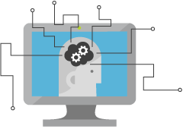
What is Machine Learning (ML)
Computing Systems that become smarter with Experience
Experience = Past Data + Human Input

Slide 3






What is Machine Learning (ML)

Slide 4



Why now?
+
+
=

Slide 5
Machine Learning Process Model
Idea
Business Knowledge
Data Understanding
Data
Data Preparation
Modelling
Evaluation
Publish
Based on the CRISP-DM Model

Slide 6
What is Azure Machine Learning
Data
Clients
API
ML STUDIO
Model is now a web service that is callable
Blobs and Tables
Hadoop (HDInsight)
Relational DB (Azure SQL DB)
Integrated development environment for Machine Learning
Monetize the API through our marketplace
Notes:
The elegance of the solution is in its simplicity – something that has been lacking in the machine learning space
The first issue many enterprises face is data ingestion. With the cloud, you can bring in data sources with the ease of a drop down or drop your on-premises data set into the built in storage space. Users can then model in our development environment – Machine Learning Studio
where we’re offering R, Python and SQLite as first class citizens in addition to our world-class Microsoft algorithms.
The second issue – and often the primary one – is putting finished work into production in a way others can use. Client devices, websites, mobile applications, excel spreadsheets you name it anything that supports HTTP requests.
We’ve heard from many data scientists that they model in R on a Linux stack but then have to hand over their work to developers who need to translate that into another language to actually make it work.
This time consuming and unnecessary process has been eliminated with our system, as the model is with a click transformed into a web service end-point that can run over any data, anywhere and connect to any solution or client.
Next, not only can this model be put into production for your company, it can be made available for the world on our Machine Learning Marketplace. Microsoft hosts your solution and markets it for you, while you have the freedom to brand and monetize as you see fit.

Slide 7
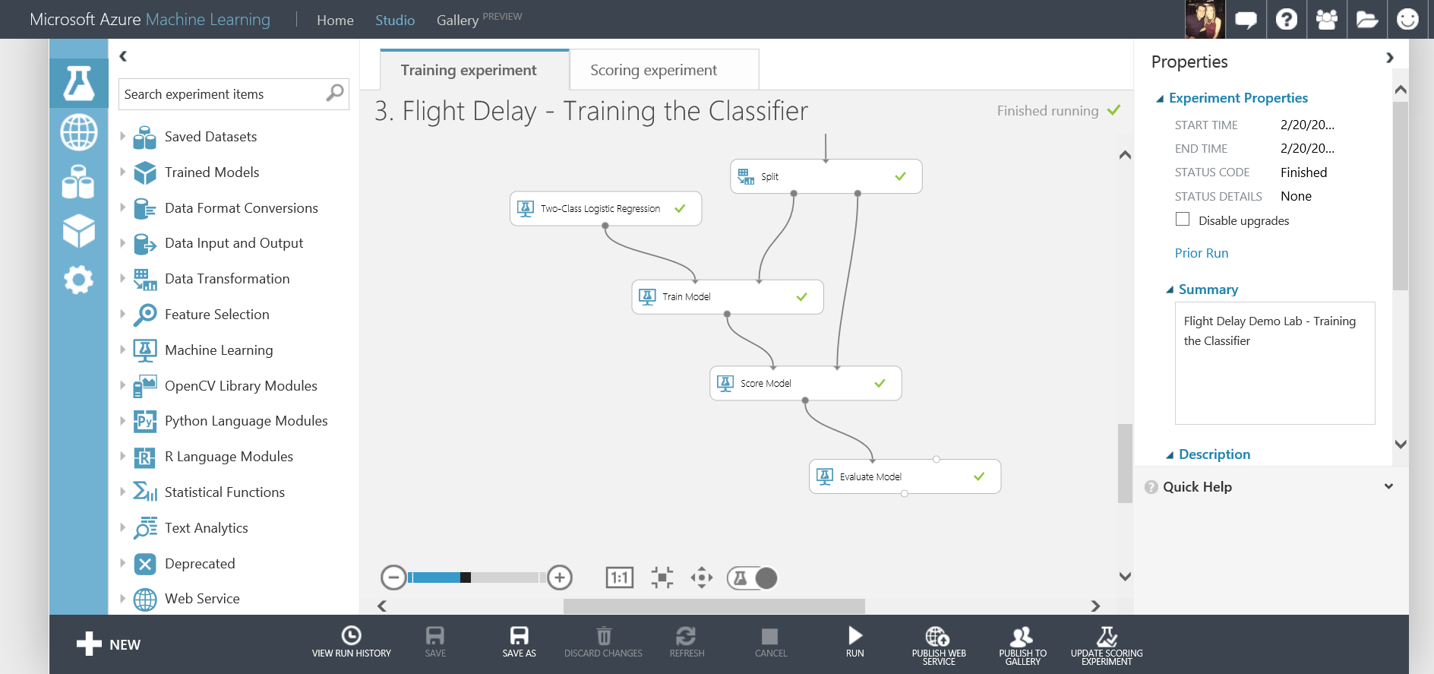
What is Azure Machine Learning
Fully managed cloud service
Accessed via a browser
Best in class machine learning algorithms
Support for R/Python/SQL
Collaborative data science
Quickly deploy models as web services
Publish to a Gallery

Slide 8
Azure ML Studio Demo
Flight Delay Scenario
Full Tutorial Document available on GitHub
https://github.com/amykatenicho/DataCultureSeries

Slide 9
Our Scenario
Create and publish a model that predicts:
Will a flight be delayed given a range of flight details and weather data.
Using two datasets: flight delay data and weather data
The model created will be a form of Supervised Learning and will use Binary Classification
Use historical flight and weather data to predict if a future flight is delayed or not.
Finally produce a web service you can query with new flights to gain a prediction

Slide 10
Azure ML Studio Demo
Digit Recognition Demo

Slide 11
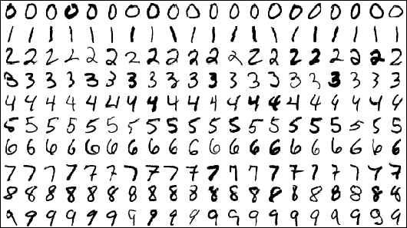
Our Scenario
Using a popular MNIST dataset – commonly used in Machine Learning Scenarios for testing Image Processing Systems
42,000 Images, each image is 28 x 28 pixels and each pixel has a value from 0 – 255
No images but a CSV file – 785 columns: label and 784 pixel colours

Slide 12
Azure ML Studio Demo
Integrate R/Python into Azure ML
Extra Resources Available on GitHub https://github.com/amykatenicho/DataCultureSeries

Slide 13
Azure ML Studio Demo
Jupiter Notebooks
More information: http://blogs.technet.com/b/machinelearning/archive/2015/07/24/introducing-jupyter-notebooks-in-azure-ml-studio.aspx

Slide 14
Azure ML Studio Demo
Retrain Machine Learning Models
More information: http://blogs.technet.com/b/machinelearning/archive/2015/07/24/introducing-jupyter-notebooks-in-azure-ml-studio.aspx

Slide 15
Machine Learning API’s
Project Oxford, Announced at //BUILD
http://www.projectoxford.ai/

Slide 16




What is Project Oxford?
A portfolio of REST APIs and SDKs which enable developers to write applications which understand the content within the rapidly growing set of multimedia data

Slide 17


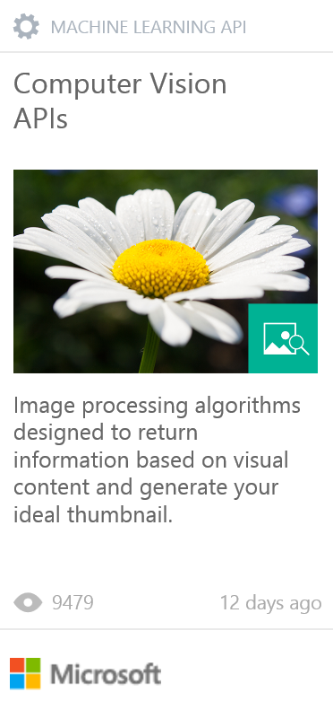
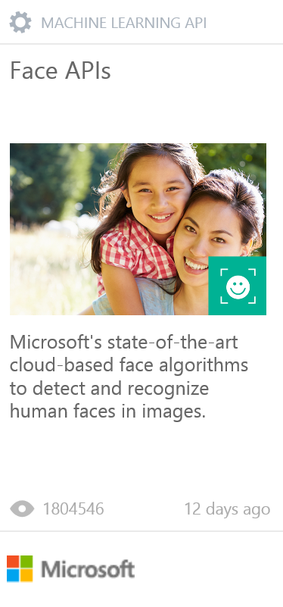
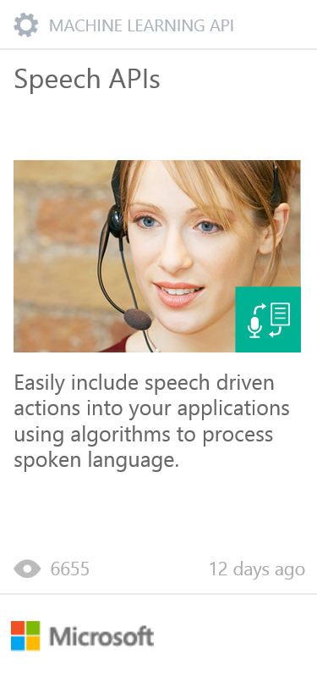
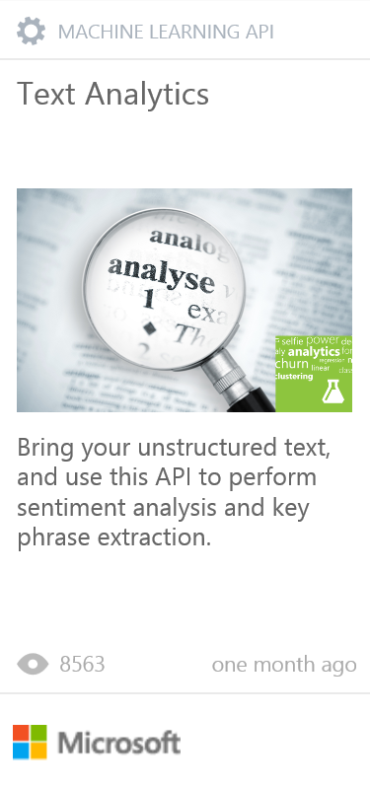
PROJECT OXFORD
Vision APIs
Face APIs
Speech APIs
LUIS
(Language Understanding Intelligent Service)
Speech Recognition
Analyze Image
Face Detection
Detect Intent
Text to Speech
OCR
Face Grouping
Determine Entities
Generate Thumbnail
Face Identification
Speech Intent Recognition
Improve Models

Slide 18
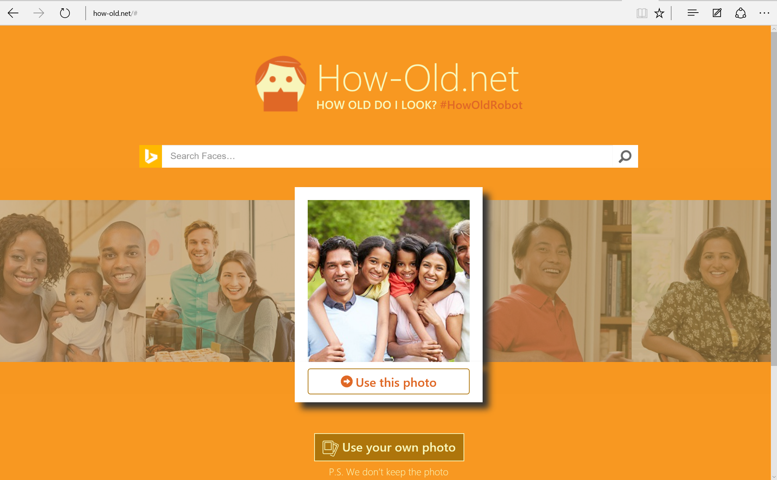

Slide 19
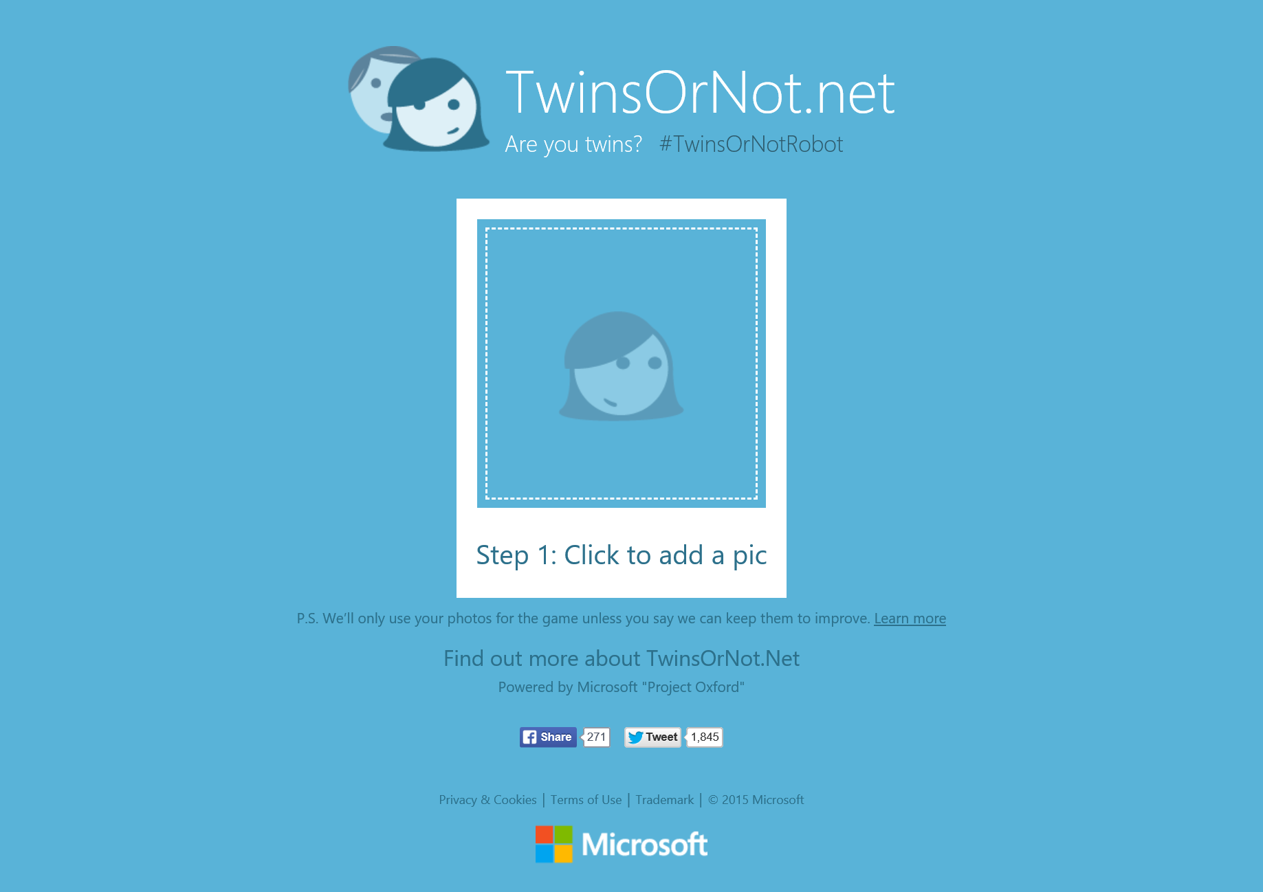

Slide 20
Azure Data Journeys
Other Data Services Avaliable on Azure
Notes:
Azure Machine Learning is just one of many data services avalibale on Azure
and there are many different routes you can take to create your perfect data journey

Slide 21
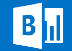










c
Visualisation
Power BI
Orchestration
S
Storage
Compute
Service bus
Stream Analytics
IoT
Table Storage
Event Hub
Feeds
HD Insight
Blob Storage
Data Sources
Data Factory
Machine Learning
SQL Azure
SQL Data Warehouse
Virtual Machines
Data Lake
Azure
Document DB

Slide 22
Predictive Analytics
c
Visualisation
Power BI
Orchestration
S
Storage
Compute
Service bus
Stream Analytics
IoT
Table Storage
Event Hub
Feeds
HD Insight
Blob Storage
Data Sources
Data Factory
Machine Learning
SQL Azure
SQL Data Warehouse
Virtual Machines
Data Lake
Azure
Document DB

Slide 23
Near real time analysis
c
Visualisation
Power BI
Orchestration
S
Storage
Compute
Service bus
Stream Analytics
IoT
Table Storage
Event Hub
Feeds
HD Insight
Blob Storage
Data Sources
Data Factory
Machine Learning
SQL Azure
SQL Data Warehouse
Virtual Machines
Data Lake
Azure
Document DB

Slide 24
Big Data
c
Visualisation
Power BI
Orchestration
S
Storage
Compute
Service bus
Stream Analytics
IoT
Table Storage
Event Hub
Feeds
HD Insight
Blob Storage
Data Sources
Data Factory
Machine Learning
SQL Azure
SQL Data Warehouse
Virtual Machines
Data Lake
Azure
Document DB

Slide 25
“Traditional” BI
c
Visualisation
Power BI
Orchestration
S
Storage
Compute
Service bus
Stream Analytics
IoT
Table Storage
Event Hub
Feeds
HD Insight
Blob Storage
Data Sources
Data Factory
Machine Learning
SQL Azure
SQL Data Warehouse
Virtual Machines
Data Lake
Azure
Document DB

Slide 26

Next Steps
Explore the other Data Services available on Azure
Follow @Fur_Bi!
Find Azure ML Tutorials Available in the Gallery
Build you own solutions using Azure ML!
Get inspired by the examples in the Gallery and start exploring!
Watch the webinars on the Machine Learning Blog http://blogs.technet.com/b/machinelearning/
Can’t get enough? Join us at Future Decoded 2015 https://futuredecoded.microsoft.com/technical-day/
Do you have your own ideas?...

Slide 27
Internet of Things & Data Innovation Programme
Are you connecting things and data in new ways?
Get $120k Free Azure Cloud, Tech, Tools
Microsoft Technology & Go To Market Support
And more!
Apply Now until September 30th
http://aka.ms/iotdatainnovation

Slide 28



Thanks for Listening
bifurt@microsoft.com
@Fur_Bi

Slide 29
Resources
Microsoft Azure Machine Learning Algorithm Cheat Sheet
Microsoft Azure Machine Leaning Documentation https://azure.microsoft.com/en-us/documentation/services/machine-learning/
Channel 9 getting started videos for Azure Machine Learning: http://channel9.msdn.com/Search?term=Azure%20Machine%20Learning#ch9Search&lang-en=en
Using the Azure Machine Learning re-training API: http://azure.microsoft.com/en-us/documentation/articles/machine-learning-retrain-models-programmatically/
Azure Machine Learning webinars available online to sign up to: https://azureinfo.microsoft.com/BigDataAdvancedAnalyticsWebinars.html
Azure Machine Learning Blog: http://blogs.technet.com/b/machinelearning/
Introducing Jupyter Notebooks in Azure ML Studio: http://blogs.technet.com/b/machinelearning/archive/2015/07/24/introducing-jupyter-notebooks-in-azure-ml-studio.aspx
EXCEL add-in for Azure ML https://azure.microsoft.com/en-us/documentation/articles/machine-learning-excel-add-in-for-web-services/

